Slide 1

Database Systems
Course Code: CS-213
Credit Hours: 4(3-1)
Muhammad Ejaz Bashir
Lecturer
Department of Computational Sciences

Slide 2
Content of Lecture
Advance SQL
  JOIN
  UNION

Slide 3
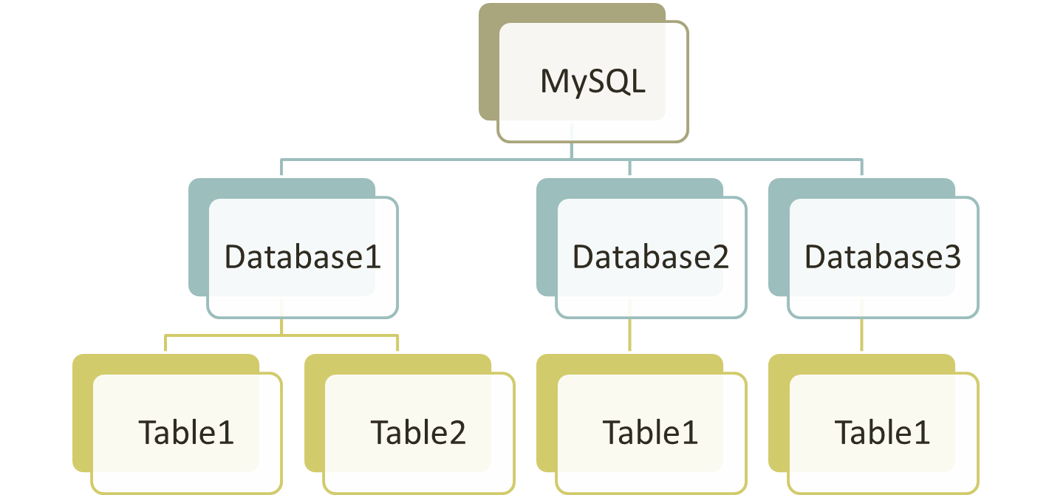
INTRODUCTION
In last lecture, we learned how to write simple SQL statements
SQL for manipulating a table and the data within the table
SQL for manipulating a database

Slide 4

INTRODUCTION
What if the data you need is stored in not one table but in multiple tables?
Can we display the following using SQL?
StudentId | Name | DepartmentNumber
1 | Aamir Ali | 2
2 | Sadia | 1
DepartmentNumber | Name
1 | Business
2 | IT
Student table
Department Table
StudentId | Name | DepartmentName
1 | Aamir Ali | IT
2 | Sadia | Business

Slide 5
SQL JOIN
As the name shows, JOIN means to combine something.
In case of SQL, JOIN means "to combine two or more tables".
Why SQL JOIN is used?
If you want to access more than one table through a select statement.
If you want to combine two or more tables then SQL JOIN statement is used. It combines rows of those tables in one table and one can retrieve the information by a SELECT statement.
The joining of two or more tables is based on a common field between them.
SQL INNER JOIN also known as simple join is the most common type of join.

Slide 6





JOIN
In SQL, JOIN can be used to combine the rows of two or more tables
Types of JOIN
CROSS JOIN
INNER JOIN
OUTER JOIN
SELF JOIN
MULTIPLE JOIN

Slide 7
JOIN
CROSS JOIN
With cross join, the result is obtained by combining each row from 1st table with each row from 2nd table
Name | DepartmentId
Aamir | 10
Sadaf | NULL
DepartmentId | Name
10 | IT
15 | Finance
Employee table
Department table
Result:
Name | DepartmentId | DepartmentId | Name
Aamir | 10 | 10 | IT
Sadaf | NULL | 10 | IT
Aamir | 10 | 15 | Finance
Sadaf | NULL | 15 | Finance
1
2
3
4

Slide 8
JOIN
CROSS JOIN
Cross join is often considered the simplest form of JOIN as it simply joins every row of the tables without taking any join condition into account
SQL syntax:
SELECT <column_name>, <column_name>… FROM <table_name1>, <table_name2>;

Slide 9
JOIN
CROSS JOIN
For example
The SQL would be as follows
Name | DepartmentId | DepartmentId | Name
Aamir | 10 | 10 | IT
Sadaf | NULL | 10 | IT
Aamir | 10 | 15 | Finance
Sadaf | NULL | 15 | Finance
SELECT * FROM Employee, Department;

Slide 10
JOIN
CROSS JOIN
An alternative SQL syntax
For example
SELECT <column_name>, <column_name>… FROM <table_name1> CROSS JOIN <table_name2>;
SELECT * FROM Employee CROSS JOIN Department;
SELECT * FROM Employee, Department;

Slide 11
JOIN
CROSS JOIN
When performing a JOIN, the resulting table columns can have the same column names
Both columns have the same name
Name | DepartmentId | DepartmentId | Name
Aamir | 10 | 10 | IT
Sadaf | NULL | 10 | IT
Aamir | 10 | 15 | Finance
Sadaf | NULL | 15 | Finance
Department.DepartmentId (Department table)
Employee.DepartmentId (Employee table)

Slide 12
JOIN
CROSS JOIN
For example, to display only the first two columns of the resulting cross join
SELECT Employee.Name, Employee.DepartmentId FROM Employee, Department;
Result:
Name | DepartmentId
Aamir | 10
Sadaf | NULL
Aamir | 10
Sadaf | NULL
You cannot use Name and DepartmentId here as the columns have the same name

Slide 13
JOIN
CROSS JOIN
For example, to display the first and third column of the resulting cross join
SELECT Employee.Name, Department.DepartmentId FROM Employee, Department;
Result:
Name | DepartmentId
Aamir | 10
Sadaf | 10
Aamir | 10
Sadaf | 15
You cannot use Name and DepartmentId here as the columns have the same name

Slide 14
JOIN
INNER JOIN
Inner join is the most common type of JOIN. With inner join, the result will only combine the rows of the tables if the join conditions are satisfied
SQL Syntax:
SELECT <column_name>, <column_name>… FROM <table_name1>, <table_name2> WHERE <conditions>;

Slide 15
JOIN
INNER JOIN
For example
Name | DepartmentId
Aamir | 10
Sadaf | NULL
DepartmentId | Name
10 | IT
15 | Finance
Employee table
Department table
Run:
SELECT * FROM Employee, Department WHERE Employee.DepartmentId = Department.DepartmentId;
Result:
Name | DepartmentId | DepartmentId | Name
Aamir | 10 | 10 | IT
1

Slide 16
JOIN
INNER JOIN
An alternative SQL syntax
For example
SELECT <column_name>, <column_name>… FROM <table_name1> INNER JOIN <table_name2> ON <conditions>;
SELECT * FROM Employee INNER JOIN Department ON Employee.DepartmentID = Department.DepartmentID;

Slide 17
JOIN
INNER JOIN
With inner join, if the join conditions are all based on the equal (=) operator, this type of inner join is also known as Equi-join
For example
SELECT * FROM Employee, Department WHERE Employee.DepartmentID = Department.DepartmentID;
Both inner join and equi-join

Slide 18
Activity 1
CLASS ACTIVITY
Write down the SQL for displaying the employees along with the contact number of each employee. Draw the resulting table as well
EmployeeId | Name
1 | Aamir Ali
2 | Sadia Asim
Employee table
EmployeeId | ContactNumber
1 | 111-1111
1 | 222-2222
Contact table
Answer

Slide 19
Activity 1
CLASS ACTIVITY
Answer
SELECT * FROM Employee, Contact WHERE Employee.EmployeeID = Contact.EmployeeID;
Resulting table:
EmployeeId | Name | EmployeeId | ContactNumber
1 | Aamir Ali | 1 | 111-1111
1 | Aamir Ali | 1 | 222-2222

Slide 20



JOIN
OUTER JOIN
Outer join is a variation of inner join where in some cases, the rows will be displayed in the result even if the join conditions are not satisfied
Types of outer join
LEFT OUTER JOIN
RIGHT OUTER JOIN
FULL OUTER JOIN

Slide 21
JOIN
LEFT OUTER JOIN
Left outer join is like inner join except all the rows in the left table are always returned in the result even if the rows do not satisfy the join conditions
SQL Syntax:
SELECT <column_name>, <column_name>… FROM <left_table_name> LEFT JOIN <right_table_name> ON <conditions>;

Slide 22
JOIN
LEFT OUTER JOIN
Name | DepartmentId
Aamir | 10
Sadaf | NULL
DepartmentId | Name
10 | IT
15 | Finance
Employee table
Department table
Run:
SELECT * FROM Employee LEFT JOIN Department ON Employee.DepartmentId = Department.DepartmentId;
Result:
Name | DepartmentId | DepartmentId | Name
Aamir | 10 | 10 | IT
Sadaf | NULL | NULL | NULL
1
2

Slide 23
JOIN
RIGHT OUTER JOIN
Right outer join is like inner join except all the rows in the right table are always returned in the result even if the rows do not satisfy the join conditions
SQL Syntax:
SELECT <column_name>, <column_name>… FROM <left_table_name> RIGHT JOIN <right_table_name> ON <conditions>;

Slide 24
JOIN
RIGHT OUTER JOIN
Name | DepartmentId
Aamir | 10
Sadaf | NULL
DepartmentId | Name
10 | IT
15 | Finance
Employee table
Department table
Run:
SELECT * FROM Employee RIGHT JOIN Department ON Employee.DepartmentId = Department.DepartmentId;
Result:
Name | DepartmentId | DepartmentId | Name
Aamir | 10 | 10 | IT
NULL | NULL | 15 | Finance
1
2

Slide 25
JOIN
FULL OUTER JOIN
Full outer join is like inner join except all the rows in the left and right table are always returned even if the rows do not satisfy the join conditions
SQL Syntax:
MySQL does not support full outer join
SELECT <column_name>, <column_name>… FROM <left_table_name> FULL OUTER JOIN <right_table_name> ON <conditions>;

Slide 26
JOIN
FULL OUTER JOIN
Name | DepartmentId
Aamir | 10
Sadaf | NULL
DepartmentId | Name
10 | IT
15 | Finance
Employee table
Department table
Run:
SELECT * FROM Employee FULL OUTER JOIN Department ON Employee.DepartmentId = Department.DepartmentId;
Result:
Name | DepartmentId | DepartmentId | Name
Aamir | 10 | 10 | IT
Sadaf | NULL | NULL | NULL
NULL | NULL | 15 | Finance
1
2
3

Slide 27
JOIN
SELF JOIN
Self join is when a table is joined with itself
Since both tables have the same name, we need a way to distinguish between the two tables. The solution is to give each table an alias in SQL:
SELECT <column_name>, <column_name>… FROM <table_name> <alias_1>, <table_name> <alias_2> WHERE <conditions>;

Slide 28
JOIN
SELF JOIN
DepartmentId | Name
10 | IT
15 | Finance
DepartmentId | Name
10 | IT
15 | Finance
Department table
Department table
Run:
SELECT D.DepartmentId, D.Name, E.DepartmentId, E.Name FROM Department D, Department E WHERE D.DepartmentId > E.DepartmentId;
Left table is called D, right table is called E
Result:
DepartmentId | Name | DepartmentId | Name
15 | Finance | 10 | IT
1

Slide 29
JOIN
MULTIPLE JOIN
Multiple join is when we join more than two tables
For example
ICNumber | DepartmentId
12345 | 10
54321 | NULL
DepartmentId | Name
10 | IT
15 | Finance
Employee table
Department Table
ICNumber | Salary
12345 | 3000
54321 | 3500
Salary Table

Slide 30
JOIN
MULTIPLE JOIN
Run:
SELECT Employee.ICNumber, Department.Name, Salary.Salary FROM Employee, Department, Salary WHERE Employee.DepartmentId = Department.DepartmentId AND Employee.ICNumber = Salary.ICNumber;
Result:
ICNumber | Name | Salary
12345 | IT | 3000

Slide 31
UNION
In SQL, UNION can be used to combine the results of two or more SELECT statements under the condition that the statements
  Have the same number of columns
  Have similar data type
SQL Syntax:
<select statement> UNION <select statement> UNION <select statement>…;

Slide 32
UNION
ICNumber | Name
12345 | Aamir Ali
54321 | Sadaf Amin
ICNumber | Name
12345 | Aamir Ali
32145 | Imran Anwer
Employee_HEC table
Employee_ApComs table
Run:
SELECT Name FROM Employee_HEC UNION SELECT Name FROM Employee_ApComs;
This is a valid UNION. Both SELECT produce same number of columns (1 column) and same data type (VARCHAR)
Result:
Name
Aamir Ali
Sadaf Amin
Imran Anwer
Aamir Ali
is listed only once as UNION does not list duplicates rows

Slide 33
UNION
ICNumber | Name
12345 | Aamir Ali
54321 | Sadaf Amin
ICNumber | Name
12345 | Aamir Ali
32145 | Imran Anwer
Employee_HEC table
Employee_ApComs table
Run:
SELECT Name FROM Employee_HEC UNION ALL SELECT Name FROM Employee_ApComs;
Result:
Name
Aamir Ali
Sadaf Amin
Aamir Ali
Imran Anwer
Aamir Ali is listed twice as UNION ALL allows duplicated rows

Slide 34
SUMMARY
JOIN can be used to combine the rows of two or more tables
Types of JOIN
  Cross join
  Inner join (Equi-join)
  Outer join (Left outer join, right outer join, full outer join)
  Self join
  Multiple join
UNION can be used to combine the results of two or more SELECT statements
  The SELECT statements must have same number of columns
  The SELECT statements must have similar data type
  The result of UNION has no duplicate rows
  To result of UNION ALL allows for duplicated rows

Slide 35



